Slide 1

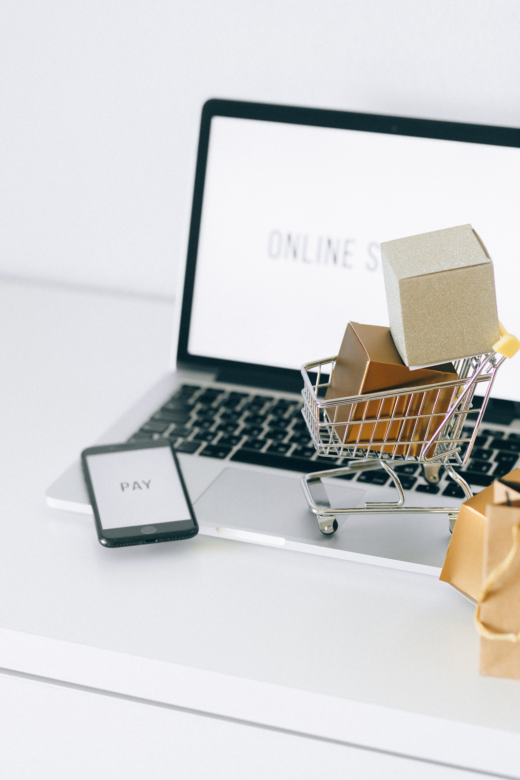
SDP PROJECT
PRESENTATION
Raikhanov Nurbek, Kenesova Adel
Rauan Zhangarbek
SE-2312

Slide 2

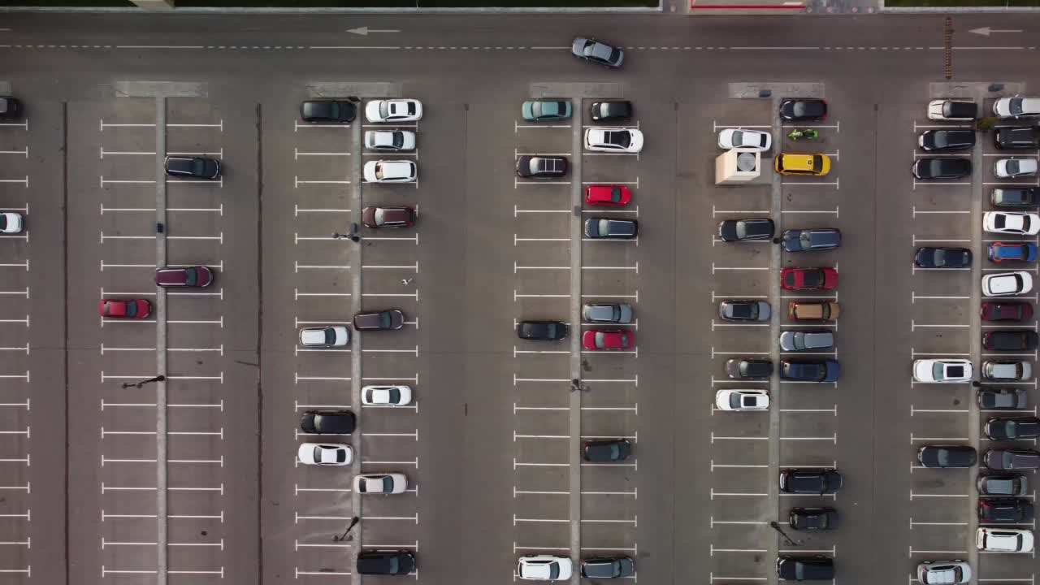
ABOUT
OUR SYSTEM
Our project is written entirely in java and additional libraries such as JavaFX. This library helps to create windowed applications, for user or admin work.
With such a fitch, we can easily interact with customers, get data about their purchases and design them according to the price.
We also used a database, to store information about employees, customers, and their purchases in a table. This was all implemented in XML, because it is kind of convenient for such machinations with saving information and transferring it.

Slide 3
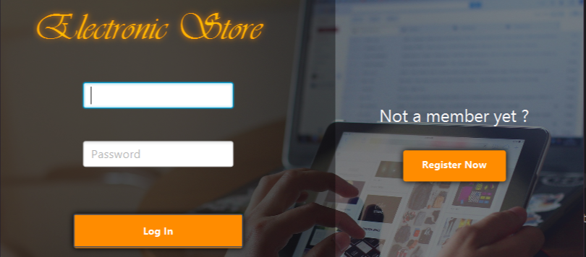
WHAT IS OUR PROJECT ABOUT?
AS YOU CAN SEE IN THE PHOTO ABOVE, IT'S AN ELECTRONIC EQUIPMENT STORE.
WE SELL DEVICES SUCH AS:
TELEVISION
SMARTPHONE
NOTEBOOK
AIR PODS
MACKBOOK
SMARTWATCH
IPHONE

Slide 4
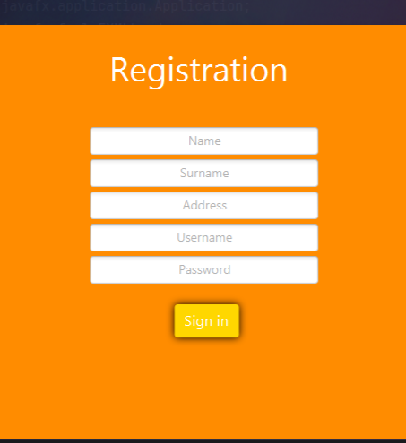
FIRST STEP
REGISTRATION
IF YOU ARE A NEW USER IN OUR STORE, YOU CAN QUICKLY REGISTER AND THEN GO TO YOUR PERSONAL ACCOUNT.
THE CLIENT SYSTEM WILL OPEN, THROUGH WHICH YOU CAN SELECT THE PRODUCT YOU NEED AND ADD IT TO YOUR CART.
ALSO THROUGH THIS PLATFORM, OUR EMPLOYEES LOG IN, ON THE SYSTEM TO THE ADMIN.

Slide 5
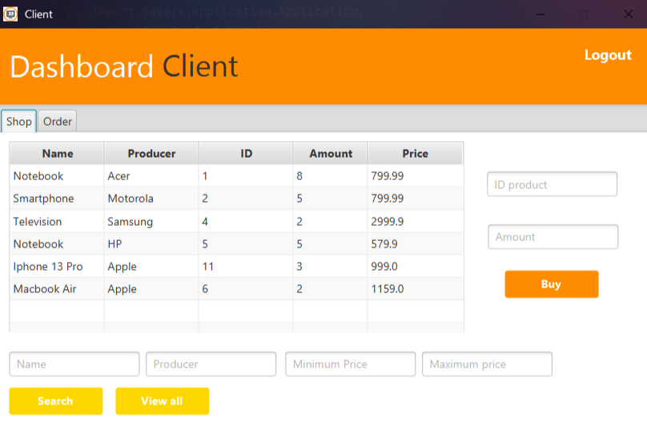
SECOND STEP
CLIENT DASHBOARD
Next, we get to the client panel. As you can see, we have sections "shop" and "order". In the "shop” section we can select the product we need, for this we need to select the product id and the amount you need. After your order is sent to the "order" section.
You can also sort the list by such criteria as name, producer, minimum price, maximum price, and further by clicking the "search" button. Or reveal all by clicking on the "view all" button.

Slide 6
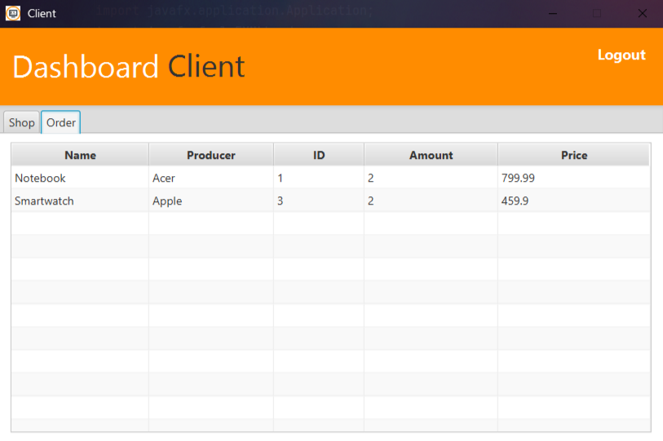
THIRD STEP
CLIENT DASHBOARD
After pressing the "Buy" button, the products selected by the customer will be automatically displayed in the Order Section.
This functionality is responsible for customer convenience. This page is intuitive and easy to navigate, allowing the customer to successfully complete the order.
This page also allows the user to review the details of their purchases to ensure they have selected the correct products, quantities.

Slide 7
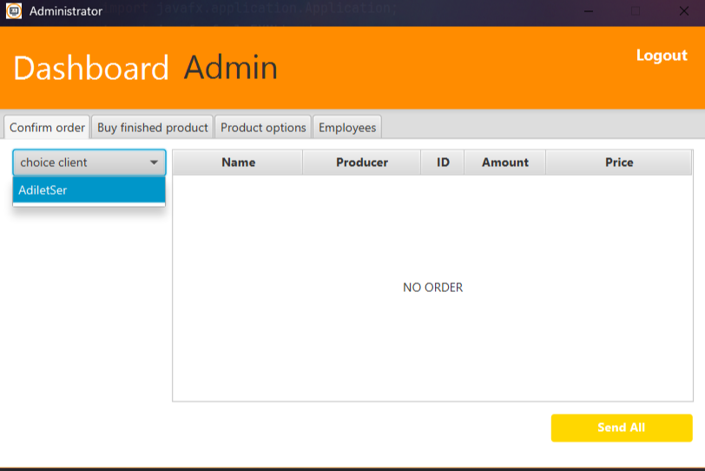
FOURTH STEP
ADMIN DASHBOARD
The next panel is Administrator. This panel has many sections such as Confirm order, Buy finished product, Product options, Employees. The first, Confirm order section tracks customer purchases.
Tracking customer purchases allows administrators to effectively manage inventory. Administrators can determine which products are in high demand and which can be removed from the assortment. This allows them to optimize the assortment and offer more relevant products to customers.

Slide 8
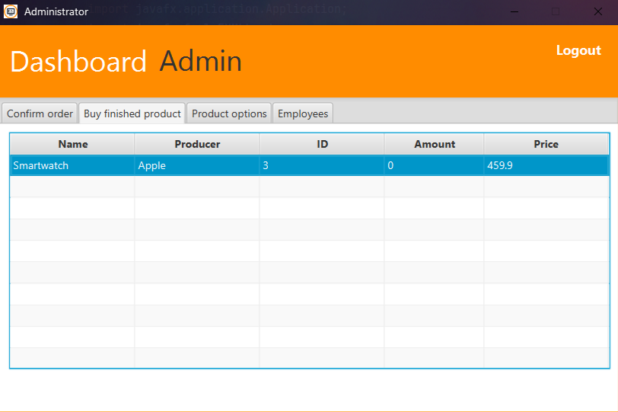
FIFTH STEP
ADMIN DASHBOARD
In the next section - Buy finished Product the quantity of products is tracked. This section allows to monitor the stock level and make timely re-purchases to avoid shortages or surpluses.

Slide 9
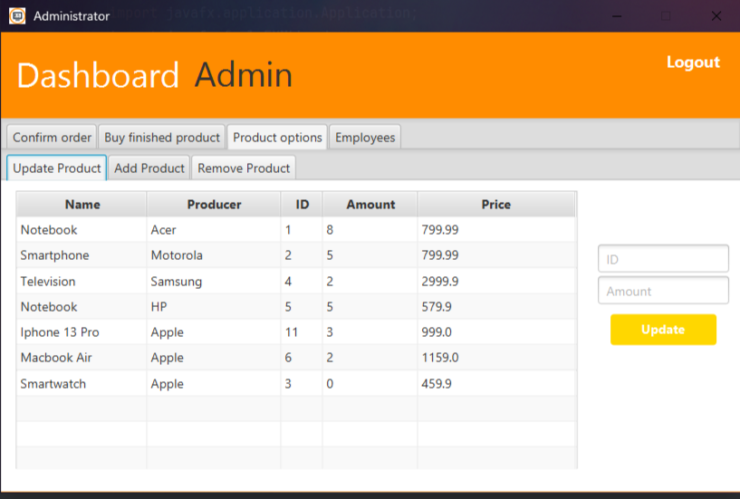
SIXTH STEP
ADMIN DASHBOARD
In the Product options section, there are sections such as Update Product, Add Product, Remove Product.
In the Update Product section, admin can update the quantity of products using their id. After defining the id and the new Amount of the product, the “Update” button should be clicked. After that administrators will be able to see the changed quantity of goods.
In the next section Add Product we can add new product by filling the products Name, Producer, id, Amount, Price.
In Remove Product section we can remove products with low demand. Deleting a product is done using id.

Slide 10
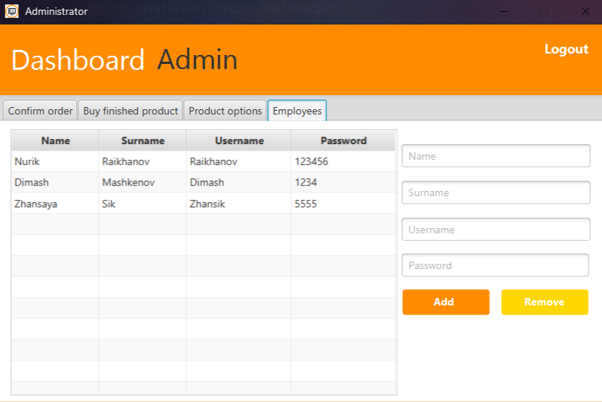
SEVENTH STEP
ADMIN DASHBOARD
The Employees section contains information about current administrators.
In case of registering new administrators, we need to fill in the Name, Surname, Username and Password of the administrator. After pressing the “Add” button, the information about the administrator will be added to the table instantly.
It is also possible to delete a current administrator. It is done in the same way as in adding, but by pressing the “Remove” button.

Slide 11
THANKS FOR YOUR ATTENTION

